Slide 1
Prabhat chauhan
CUSTOMER RETENTION

Slide 2
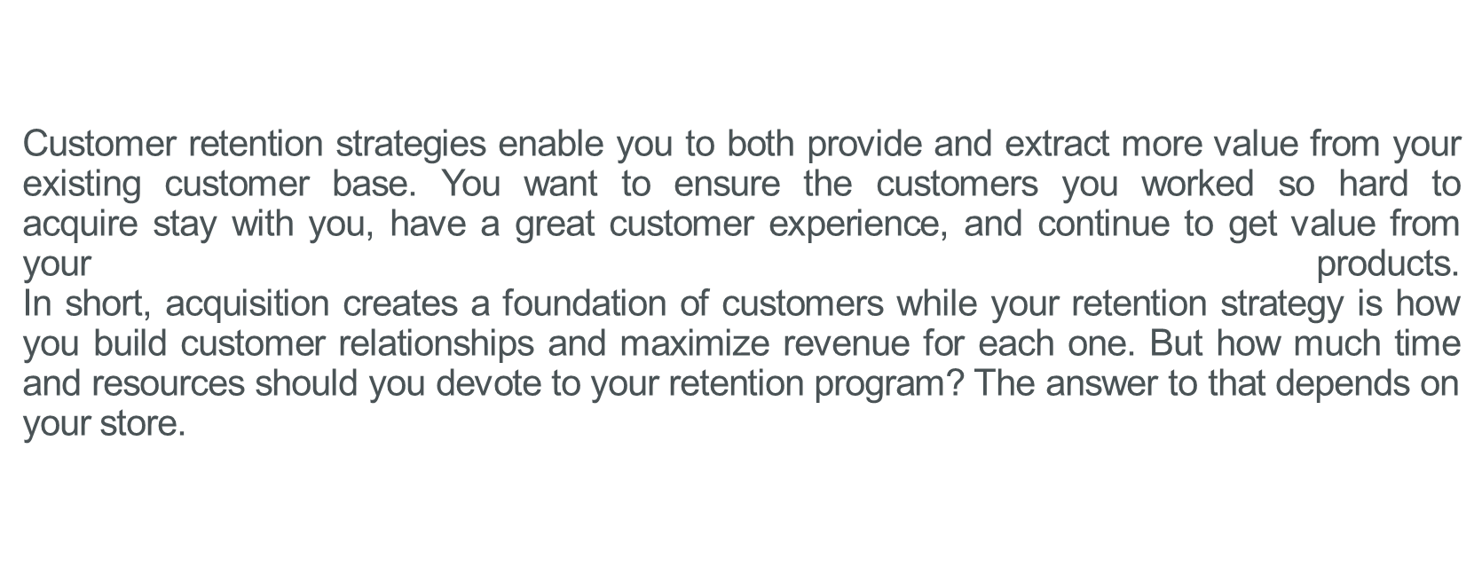

Slide 3
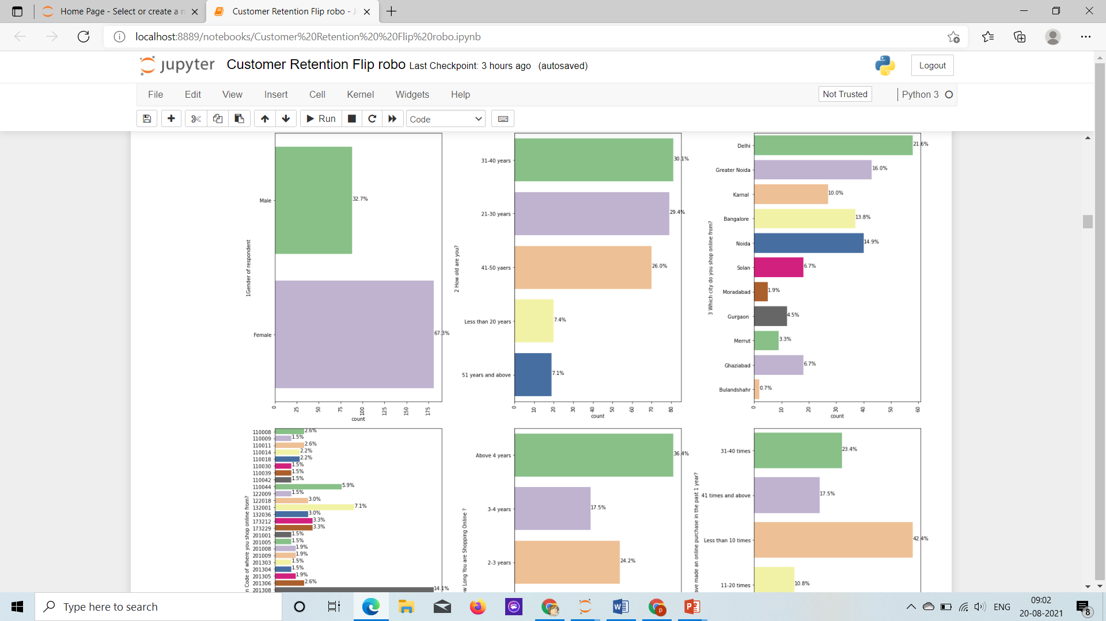

Slide 4
Larger Proportion of customer are Female around 67% of the customers.
Between the Age Group of 31-40 has 30%, After from the age of 21-30 people are 29%, Then 41-50 group with 26% of the customers. those who are less 20 and 50 are only 7%.
Largest proportion of the customers are from pincode code 201308 that 14% of the total customers, Next Highest count of customers are from pincodes 201310, 132001, 110044 with 6.7%, 7.1% and 5.9% respectively, other than than all pincodes have between 1-4% of the count of customers.
Customers above 4 in q4 how long have you been shopping online. 36% of customers have been shoping onlnie >4 years, 23% of the customers have been shopping onlnie for 2-3 years, 17% of the customers are shopping online for 3-4 years, 16% of the customers have been shopping for Less than 1 year. Least Percent of data with 5% have been shopping onlnie for 1-2%. we can sAY 75% OF the customers have shopping online more than 2 years.

Slide 5
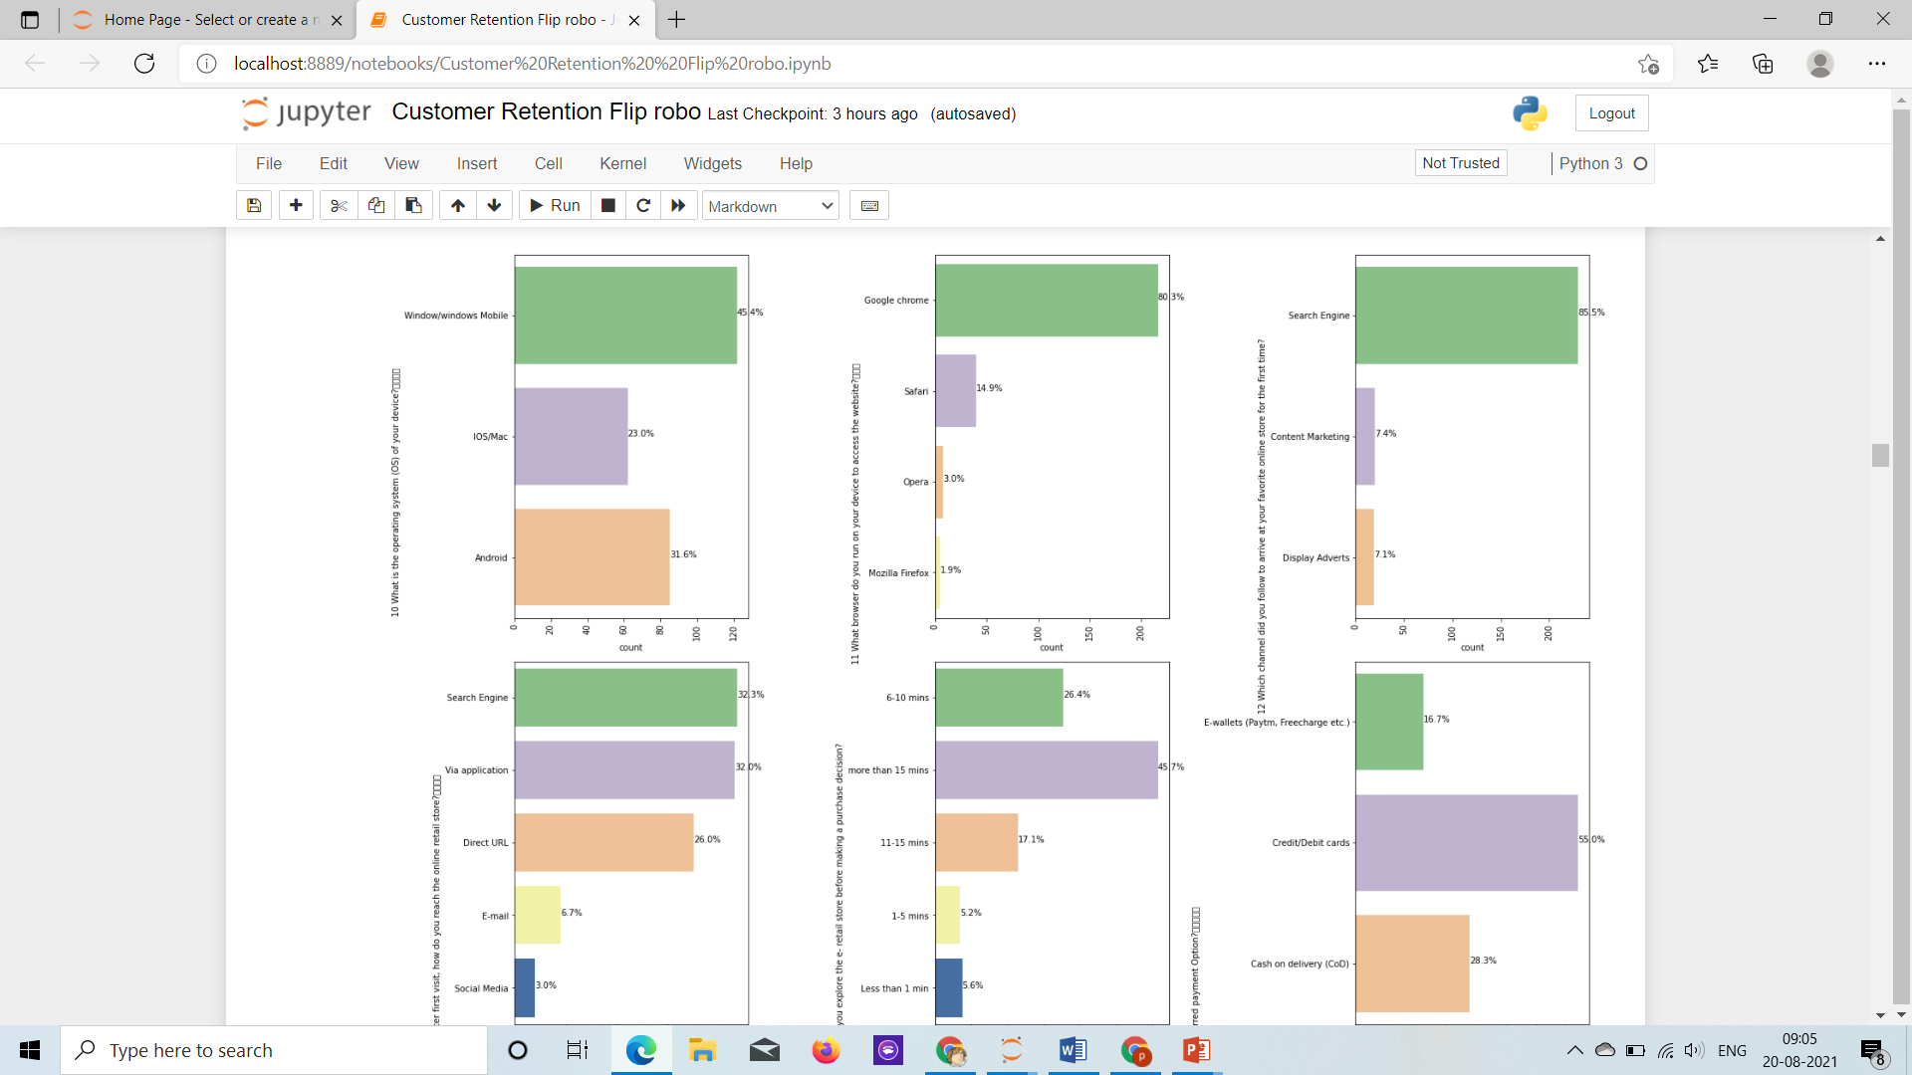

Slide 6
Devices which is favourable among people is 45% Windows Os, then 31% with android and 23% with MAC IOS.
Chrome is the most accessed site among all other browser with 80% , then 15% Safari, then Opera 3.9% and Morzilla is the least among all with 1.9%.
85.5% of the customers came to the website through search engine for favourite online store and others are through adversiment displays and content marketting which comprises of arounf 7% of the customers each.
After the First Visit how to reach the onlnie retail store, 32% of the customers reach the retail store via search engine and via application each, then 26% of the cusators reach the store via direct URL, and at the least 3% of the Custoemrs reach via Social Media, and oter 7% of the Customer reach through email. How Much time spend in the e-retail store before making a purchase,45% of the Customers take more than 15 mins before making a purchase, then 26% of the customers take 6-10 mins and 17% of the customers take 11-15mins before making a purchase. and least percent of customers take less than a min, 1-5 mins before making a purchase are 5-6% in percent of customers.

Slide 7
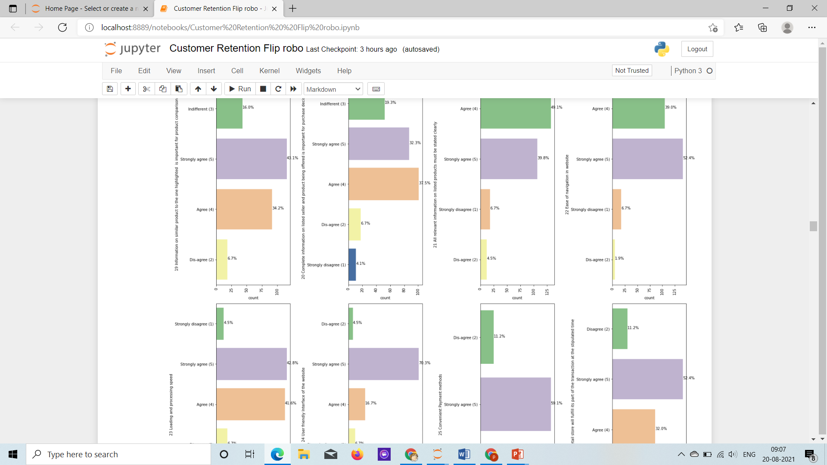

Slide 8
Information on a similar product to the one highlighted is important, 43% of the customer strongly agree and 34% of the customers agree to it, least % of customers i.e 6.7% of them disagree to the question above, 16% of the customers think the question is indifferent.
Complete information on listed seller and product being offered is important for purchase decision, 37% of the customers strongly agree to the question, where as 32% of the customers agree to the question, 19% of the customers feel the question is indifferent, 6.7% of the customers strongly disagree, 4% of the customers disagree to the question.
All relevant information on listed products must be stated clearly, 49% of the customers Agree to the question, where 40% of the customers Strongly agree to the question, 6.6% of the customers strongly disagree to the question, and 4.4% of the customers dis-agree to the question.
Ease of navigation in website, the question is strongly agreed by 52.4% of the customers, 39% of the customers agree to it, 6% of the customers strongly disagree to it and at the least 1.8% of the customers disagree to the question.

Slide 9
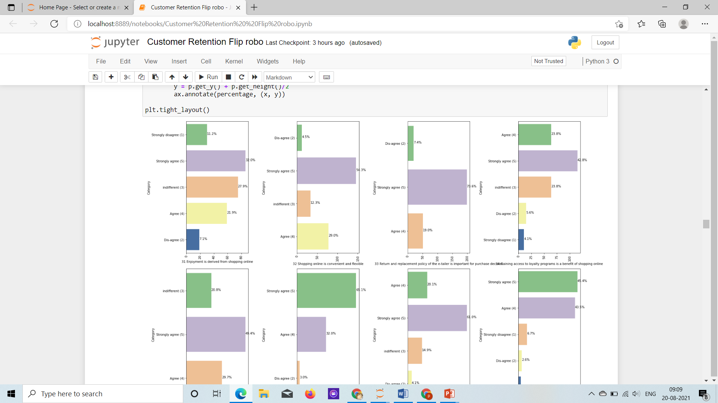

Slide 10
enjoyment is derived from shopping online, all customer have biased opions as 30% of the customers strongly agree, 28% of the customers find the fact indifferent, 21% of the customers agree to the fact and other customers disagree.
Shopping online is convient and flexible, majority of the customers(54%) strongly agree and 29% of the customers Agree to it.
Return and replacement policy of the e-tailer is important for purchase decision, majority of the customers(73%) strongly agree and 18% of the customers Agree to it and other remaining(7.5%) disagree.
Gaining access to loyalty programs is a benefit of shopping online, majority of the customers(42%) strongly agree and 23% of the customers Agree to it, 23% of the customers find the fact indifferent, and other remaining are in disagree and strongly disagree category.

Slide 11
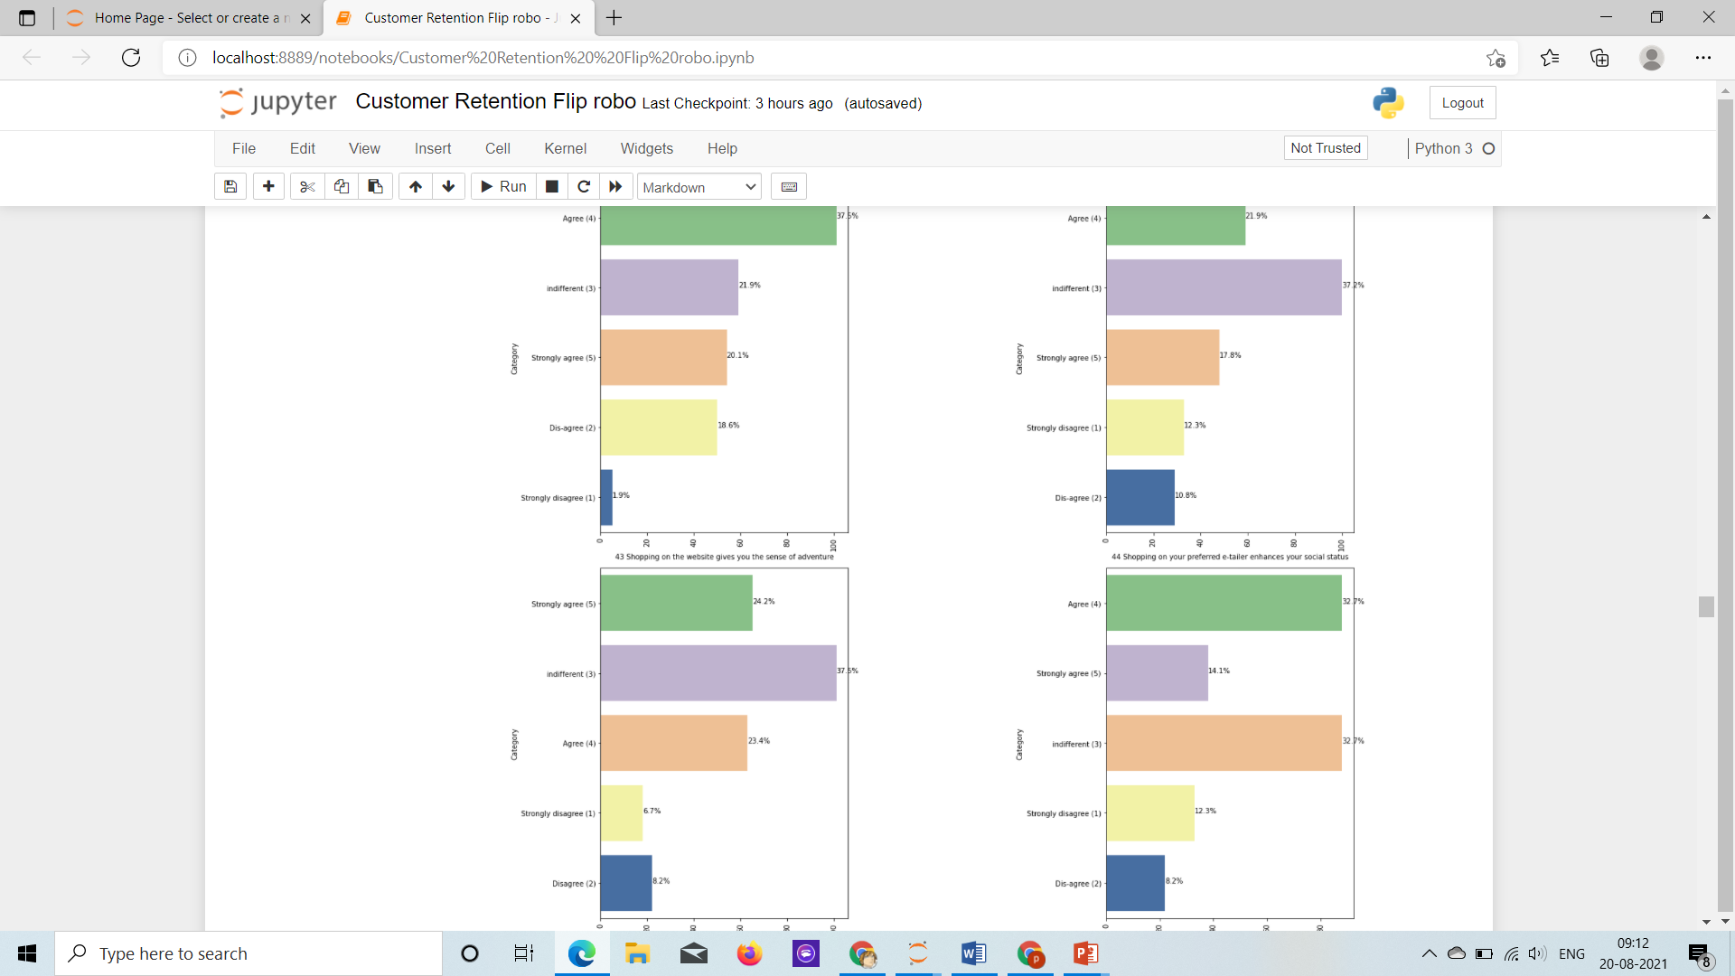

Slide 12
Shopping on the website gives you the sense of adventure, majority of the custormers(38%) agree to it, 20% of customers strongly agree, 22% of the customers find the fact indifferent, 18.5% of the customers disagree, 1.8% of the customers strongly disagree.
Shopping on your preferred e-tailer enhances your social status, majority of the custormers(37%) find it INdifferent, 17.8% of customers strongly agree, 21% of the customers agree to it, 12% of the customers strongly disagree, and remaining 10% of the customers disagree to it.
You feel gratification shopping on your favorite e-tailer, 37% of the customers find it indifferent, 24% of the customers strongly agree to it, 23% of the customers agree to it, and other 8% and 6% of the customers disagree and strongly disagree to it respectively.

Slide 13
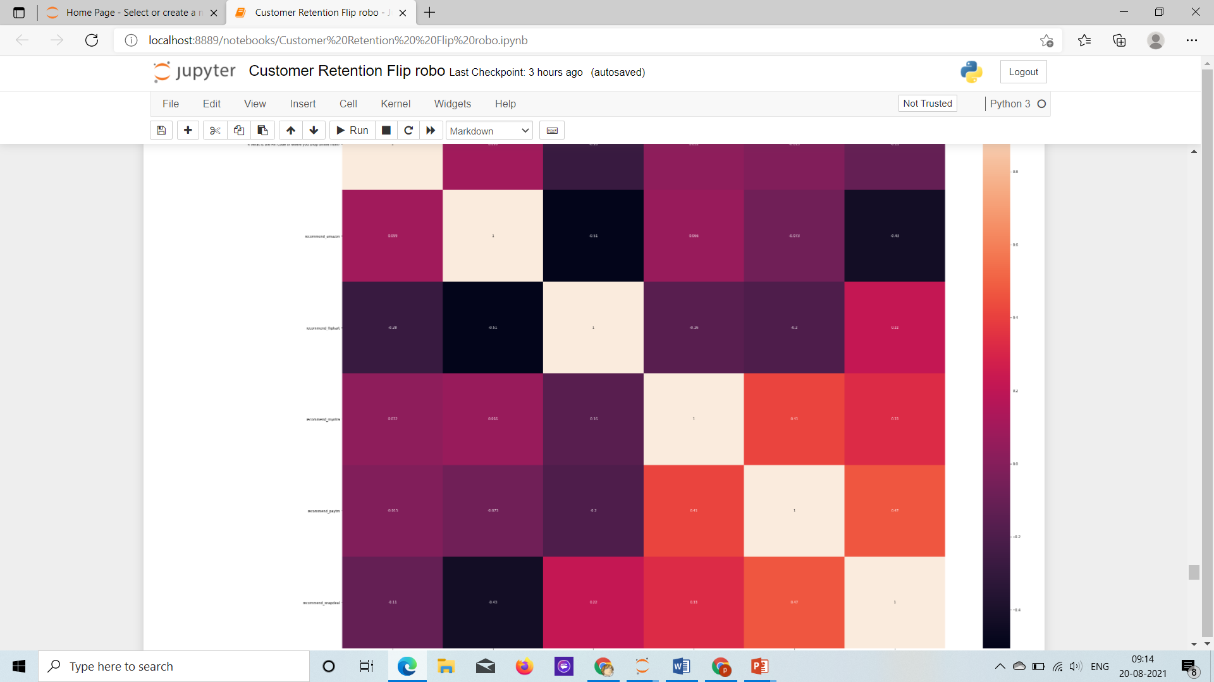

Slide 14
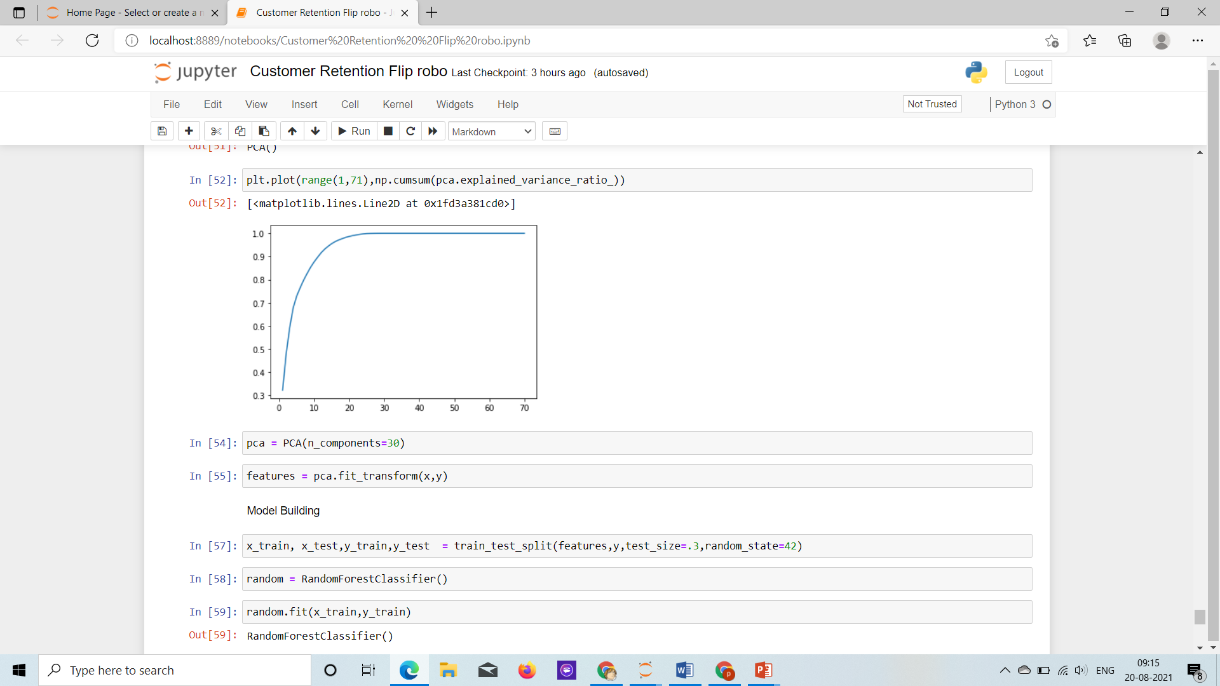

Slide 15
